Slide 1
Handwritten Digit
Recognizer
Deepak Pawade-41
Hrishikesh Kulkarni-25
Prabhakar Maity-27
Akshay Agarwal-1

Slide 2
Digit Recognition System
Digit recognition system is the working of a machine to train itself or recognizing the digits from different sources like emails, bank cheque, papers, images, etc. and in different real-world scenarios for online handwriting recognition on computer tablets or system, recognize number plates of vehicles, processing bank cheque amounts, numeric entries in forms filled up by hand (say — tax forms) and so on.

Slide 3
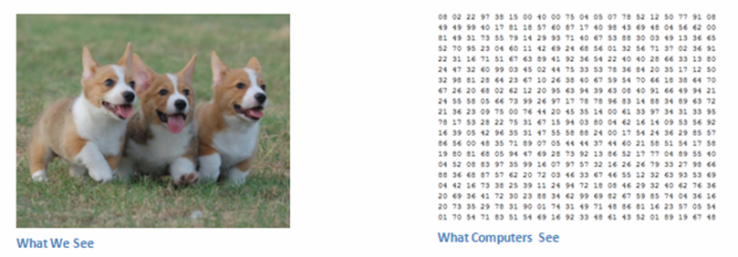
Aim:
Train the Machine Learning model to recognize handwritten digits using different libraries

Slide 4
The MNIST dataset contains 60,000 training images of handwritten digits from zero to nine and 10,000 images for testing. So, the MNIST dataset has 10 different classes. The handwritten digits images are represented as a 28×28 matrix where each cell contains grayscale pixel value.
Preprocessing
The image data cannot be fed directly into the model so we need to perform some operations and process the data to make it ready for our neural network. The dimension of the training data is (60000,28,28).

Slide 5
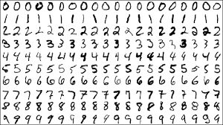
DataSet
We are training our Model using MNIST dataset,which has more than 60,000 handwritten digits.

Slide 6
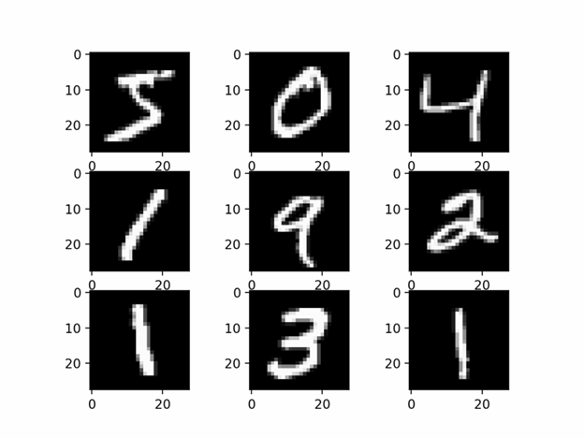

Slide 7
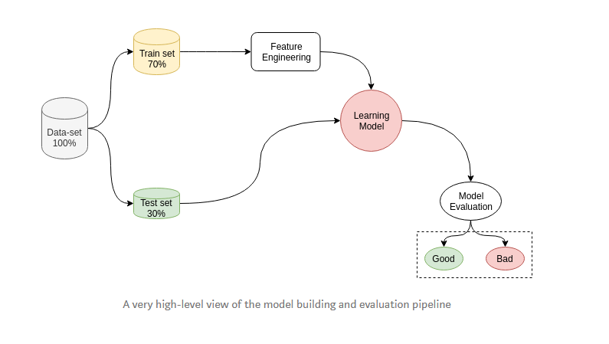
How it actually works?

Slide 8
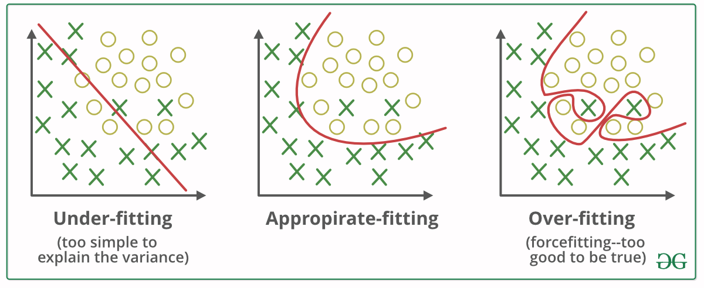
Fitting the model

Slide 9
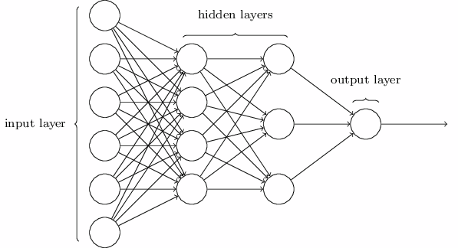
Neural Networks:
Neural Networks mimics the working of how our brain works. They have emerged a lot in the era of advancements in computational power.

Slide 10
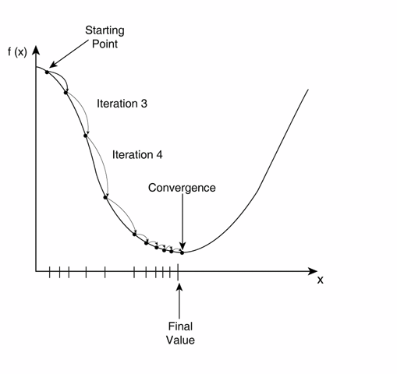
Minimizing the cost function using algorithms like gradient descent

Slide 11
CNN (convoluted Neural Networks)
Convolutional Neural Networks, CNN has become famous among the recent times. CNN is part of deep, feed forward artificial neural networks that can perform variety of task with even better time and accuracy than other classifiers, in different applications of image and video recognition, recommender system and natural language processing

Slide 12
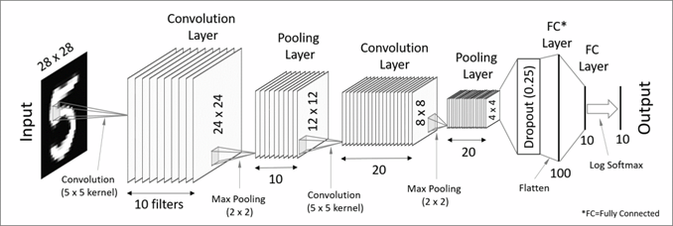
CNN
CNN architecture in MNIST dataset

Slide 13
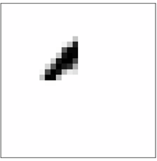
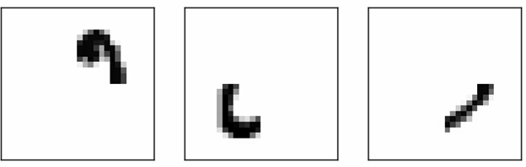
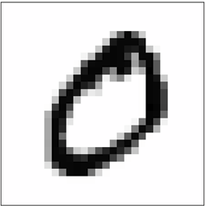

Slide 14
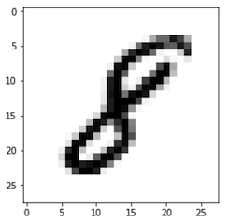
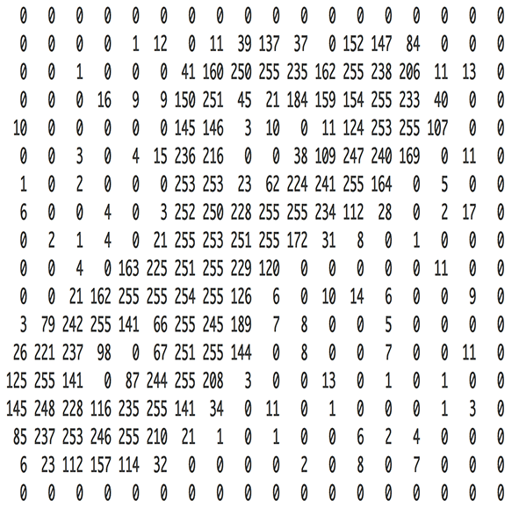
Algorithm
1.Break the image into small tiles(28x28) 784 and each tile is
saved separately
2.Feeding each tiny tile into the smaller size
neural network
3.Save the results from each small tile into a new array
4.Downsampling — to reduce the size of a newer array, downsampling is used by max-pooling.

Slide 15
Training and Testing the Model
Training:
The model.fit() function of Keras will start the training of the model. It takes the training data, validation data, epochs, and batch size.
Testing: We have 10,000 images in our dataset which will be used to evaluate how good our model works. The testing data not involved in the training of the data therefore, it is new data for our model.

Slide 16
Creating GUI to predict digits
We build an interactive window to draw digits on canvas and with a button, we can recognize the digit. The Tkinter library comes in the Python standard library. We have created a function predict_digit() that takes the image as input and then uses the trained model to predict the digit.

Slide 17

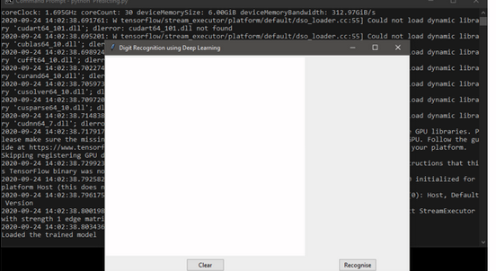
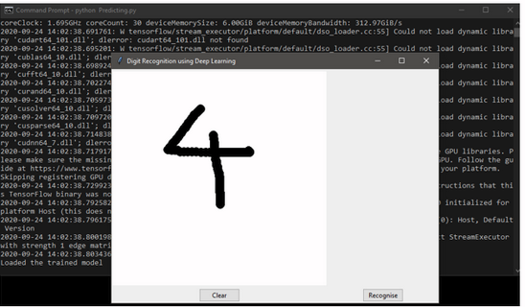

Slide 18
Hardware and Software Requirements
Software:
· Python(Programming Language)
· IDE: IDLE/Spyder/Jupyter, Google Colab
· win32gui :Python extensions for Microsoft Windows’ Provides access to much of the Win32 API, the ability to create and use COM objects, and the Pythonwin environment.
· pywin32: dependency for win32gui.
· Pillow: image managing library.
· Keras: Keras contains numerous implementations of commonly used neural-network building blocks
· TensorFlow is a free and open-source software library for dataflow and differentiable programming across a range of tasks.
· Windows 10 x64

Slide 19
Hardware requirements
User Hardware:
● Processor: Any x32 or x64 CPU with 2 or more cores.
● Primary Memory: 4GB
● Secondary Memory: 15GB
Developer Hardware:
· CPU : AMD Ryzen 5 2600
· GPU : nvidia Geforce RTX 2060
· RAM : 16GB 3000MHz DDR4
· Secondary Storage: 240 GB SSD

Slide 20

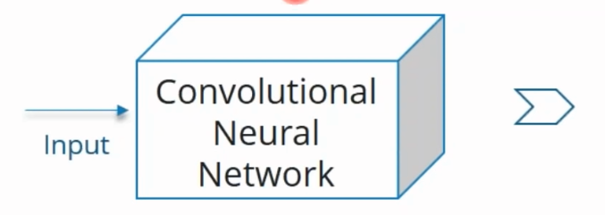
Use case:
4

Slide 21
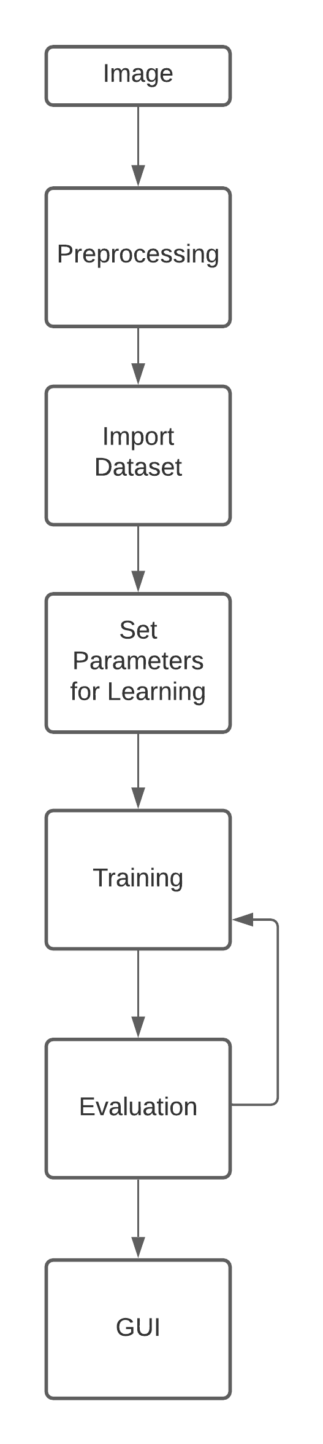
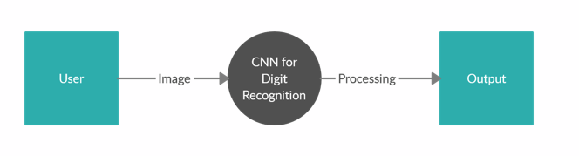
Level 0 diagrams
High Level Diagram

Slide 22
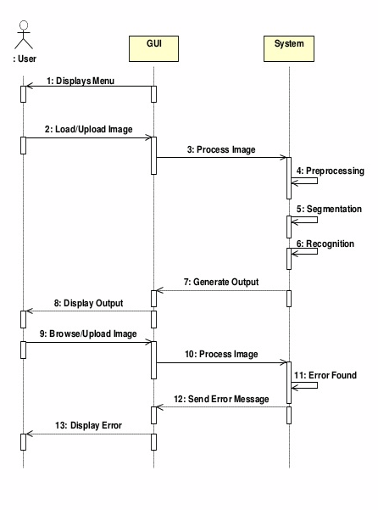
Sequence diagram

Slide 23
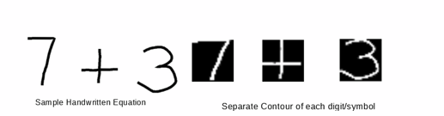
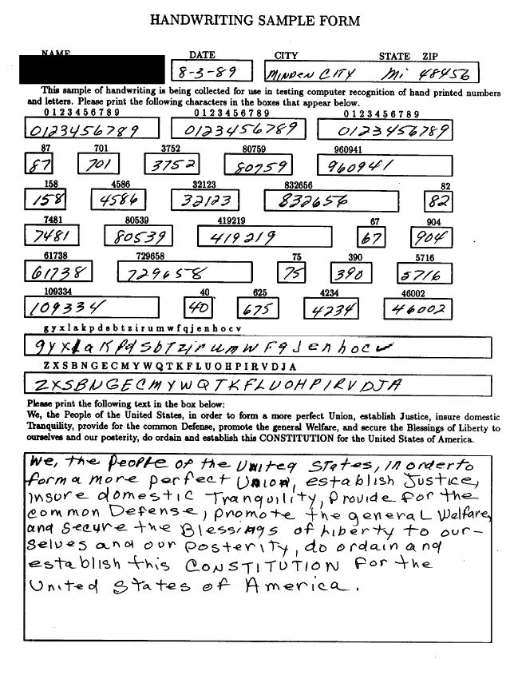
Extended Features
1.Recognize simple equations
2.Extend so that it works on NIST dataset
3.Increase the accuracy by implementing more number of epochs in hidden layers
4.Develop a similar system to identify alphabets

Slide 24
Thank you

